Slide 1



LM 35 HEAT SENSOR Project

Slide 2
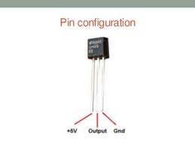
LM 35 Pin Configuration

Slide 3
Introduction to LM 35 sensor
LM 35 IS A BASIC TEMPERATURE SENSOR THAT CAN BE USED FOR EXPERIMENTAL PURPOSES.
IT CAN GIVE READINGS IN CENTIGRADE ASWELL AS FAREINHEIT SINCE THE OUTPUT VOLTAGE IS LINEARLY PROPORTIONAL TO TEMPERATURE.
SUITABLE FORMULA ARE USED TO CONVERT THE VOLTAGE READINGS INTO CENTIGRADES OR FAREINHEIT AS FOR 10mV THERE WILL BE 1 DEGGREE CHANGE IN TEMPERATURE.

Slide 4
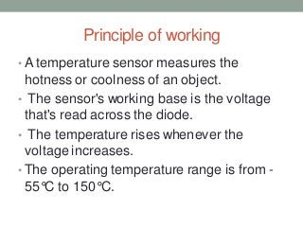

Slide 5
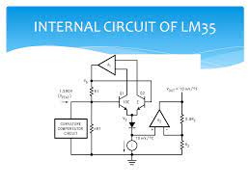

Slide 6
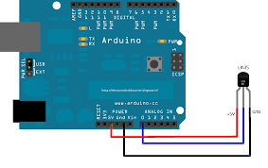
LM 35 CONNECTION WITH ARDUINO

Slide 7
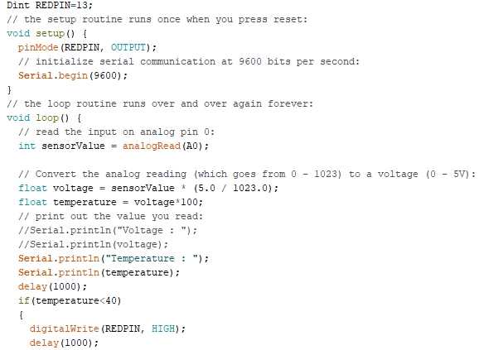
ARDUINO CODE

Slide 8
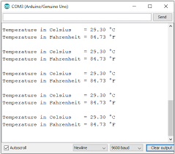
Output on serial monitor

Slide 9
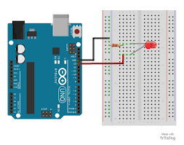
PROJECT DIAGRAM

Slide 10
THANKYOU !
Umer Naem 21K-4927
Ishma Hafeez 21K-4688
Bilal Abdul 21K-4522

